Slide 1


DRAMA DIGITAL PORFOLIO!!
By: ____________ _________

Slide 2
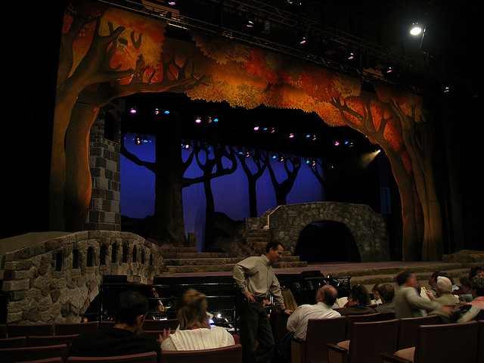
1) Your Dream Set
A) Use google images and your own creativity to create a collage and/or stage picture of the set for Into the Woods.
B) A different set could be for each scene of the play.
C) Explain why you chose these images for each scene/ scene change. This can be in partners or individual. Use terminology like balance, colour, mood, feeling, function.

Slide 3
Dream Set Rubric:
Includes all of the required elements (each of the 5 scenes, labelling of features and why this should be in the set),
is presented neatly and clearly,
reflects a sophisticated understanding of the play
Uses terminology like balance, colour, mood, feeling, function.
/20

Slide 4
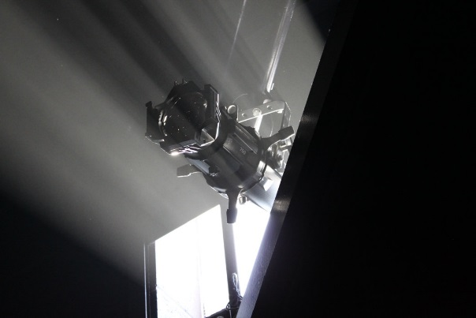
2) Lighting and Sound
Research Edmonton lighting and sound rentals (Long and Mcquade, Special Event Rentals, and others). Get a financial quote for the following:
A) Lighting behind the backdrop (dimmer bar)
B) Stand lighting for the middle of the gym
C) 13 Wireless mic rentals
D) Backdrop rentals in Edmonton
List what it will cost to rent all of these things, and a total budget.

Slide 5
Lighting and Sound Rubric
Each component has research with it, such as a screen caption or print out. /16
A) Lighting behind the backdrop (dimmer bar)
B) Stand lighting for the middle of the gym
C) 13 Wireless mic rentals
D) Backdrop rentals in Edmonton
Total budget has been estimated /4

Slide 6
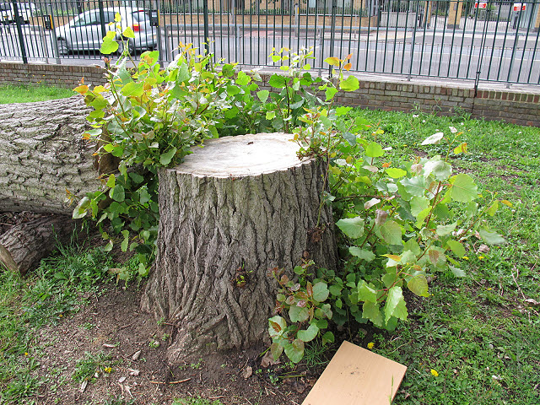
3) Styrofoam stump
Research the strategies and techniques required to create a stage tree stump, made of Styrofoam or other material.
Put visuals and create a step-by-step guide to creating it (we will have to make it soon!)
Add supplies needed

Slide 7
Tree Stump Rubric
1) Techniques are listed /4
2) Supplies are listed /4
3) Step-by-step guide is created /4

Slide 8
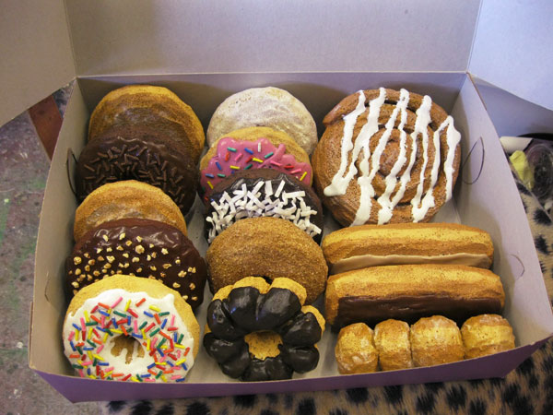
Prop Making
On Feb 17 Terri Grant, prop maker extraordinaire, is coming to teach us how to make stage food.
1) Research how to make stage food, and the supplies you need.
2) Put visuals and create a step-by-step guide to creating it (we will have to make it soon!)
3) Add supplies needed

Slide 9
Prop-making Rubric:
Budget has the 4 components asked for /4
Research is detailed /4
Total budget and separate budgets have been made /4

